Slide 1
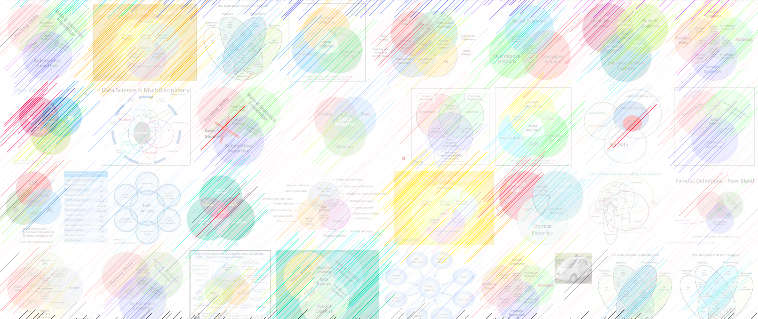

AI and art
William Trimble

Slide 2
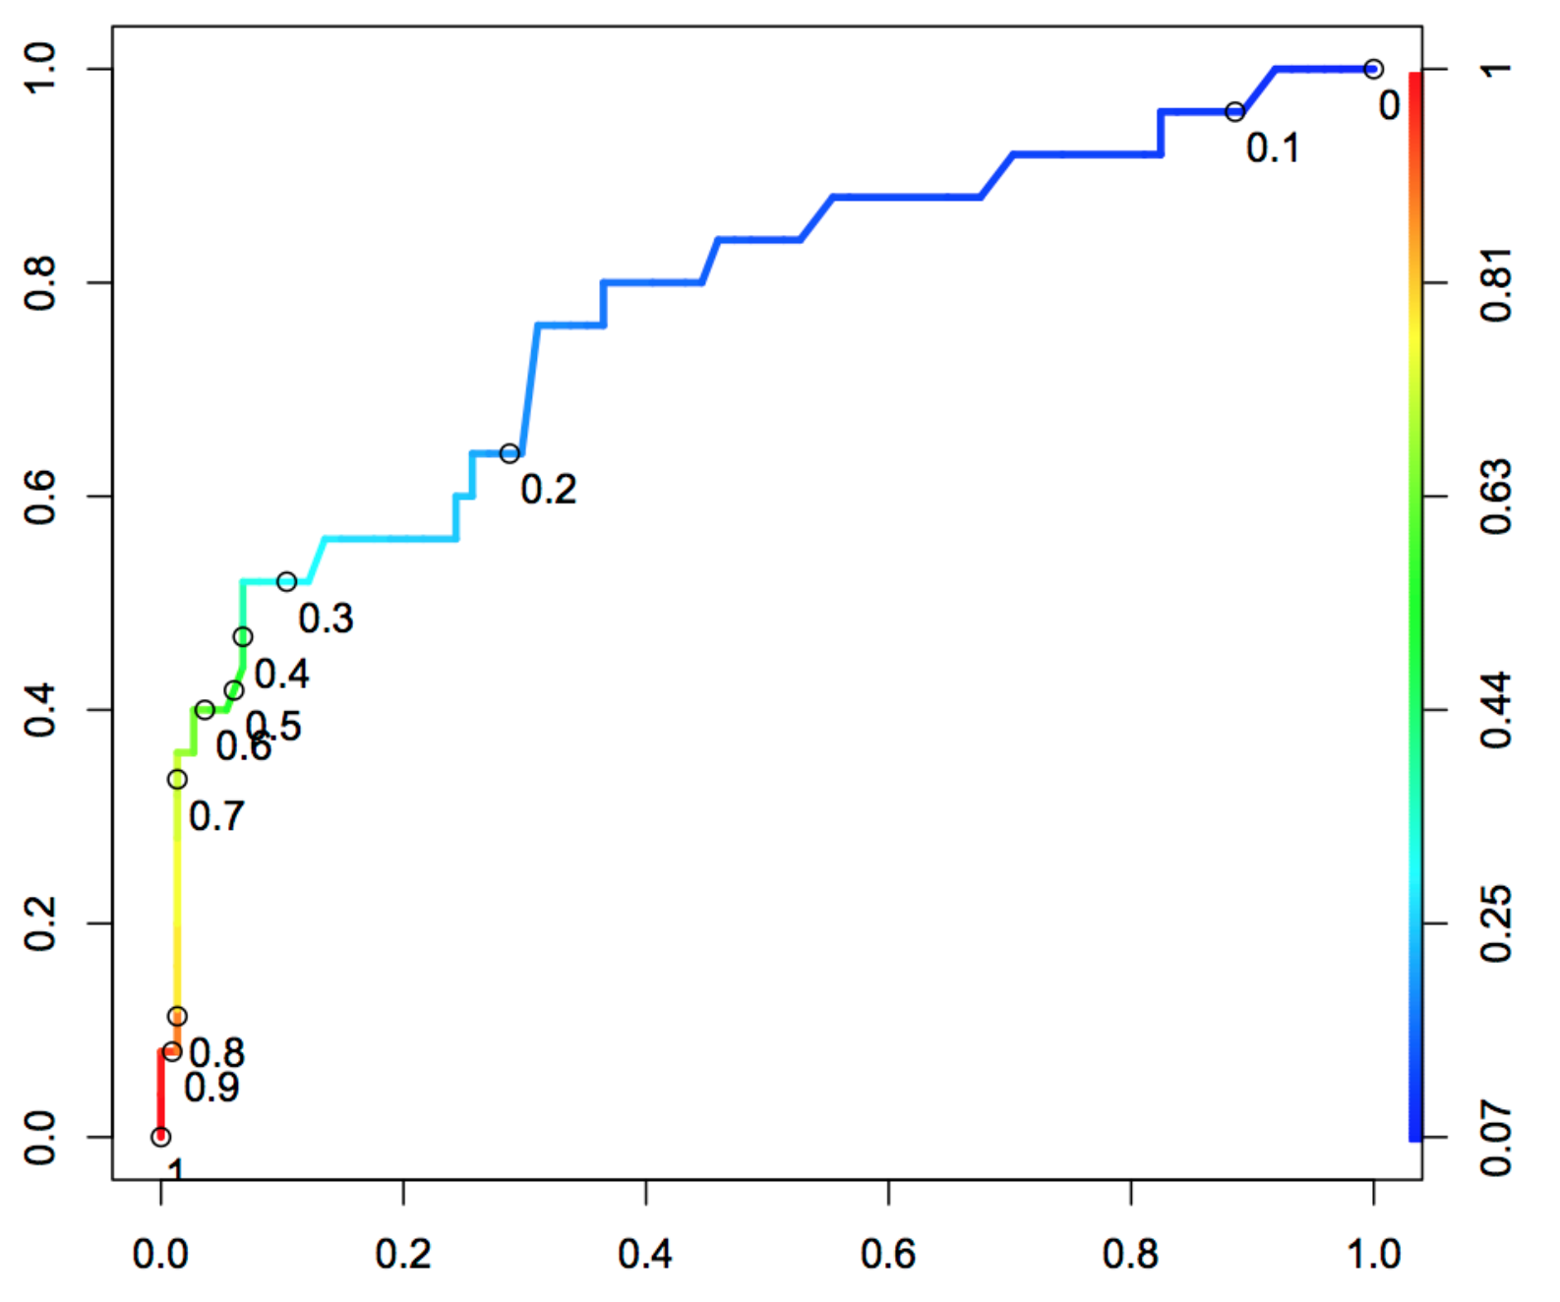
TPR
https://stats.stackexchange.com/questions/470696/threshold-coded-roc-curve-interpretaion
FPR = 1-TNR

Slide 3
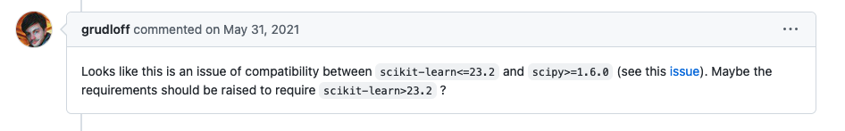
Dependency hell…
While preparing notes in spring 2022, I encountered a Unicode decode error from scikitlearn’s LogisticRegressionCV method.
Since the data was numpy arrays (no Unicode!) I took this to be a bug.
https://github.com/scikit-optimize/scikit-optimize/issues/981
Bug fix in scipy broke scikit-learn
Can anything be done?

Slide 4
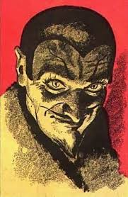
Pinned versions: A deal with the devil
When your code needs stability, you can insist on the version and subversion number of the operating system, the python engine, and the scientific libraries.
API of scientific libraries slowly evolves. “DeprecationWarning” anyone?
Expect code that specifies pinned versions to work 100% until it breaks, and then it will break catastrophically.
Pinned version code is more needy than shotgun code; it needs more hard drive space, separate computing environments, containers…

Slide 5
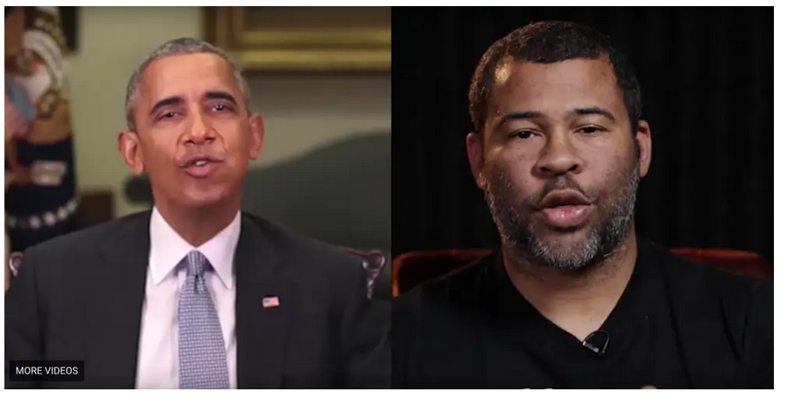
A viral video that appeared to show Obama calling Trump a 'dips---' shows a disturbing new trend called 'deepfakes’ Kaylee Fagan Apr 17, 2018, 3:48 PM
https://www.businessinsider.com/obama-deepfake-video-insulting-trump-2018-4

Slide 6
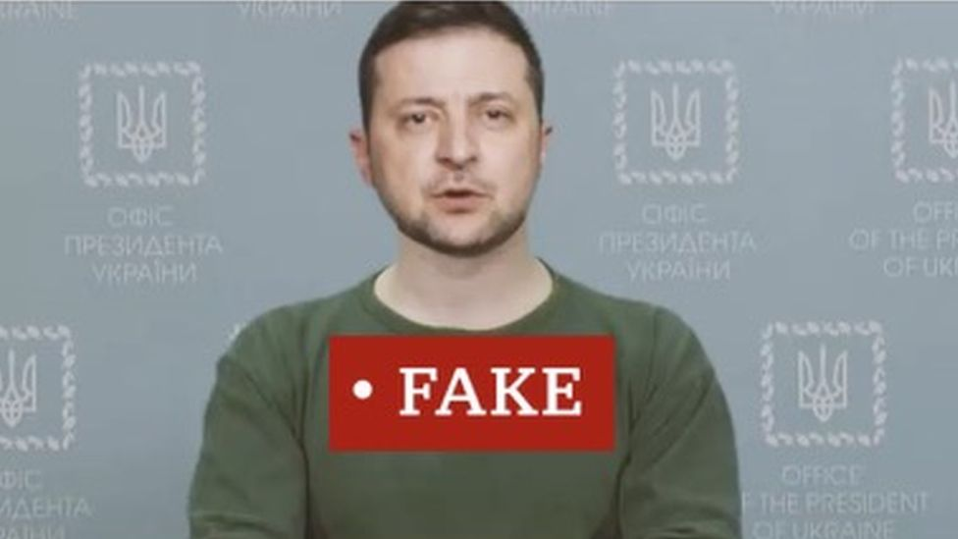
Caught in the wild (without Cassandra disclaimer)
https://www.wired.com/story/zelensky-deepfake-facebook-twitter-playbook/
Mar 17, 2022 Tom Simonite A Zelensky Deepfake Was Quickly Defeated. The Next One Might Not Be

Slide 7
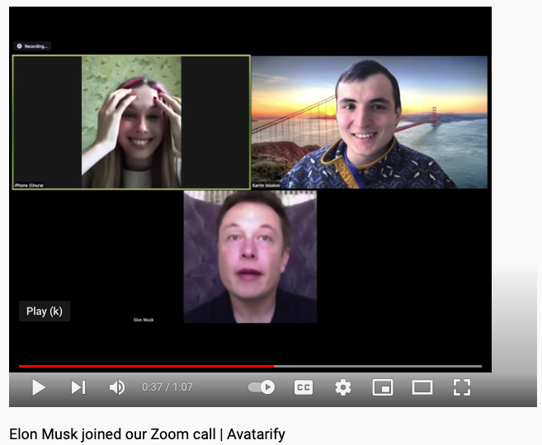
https://www.youtube.com/watch?v=lONuXGNqLO0

Slide 8
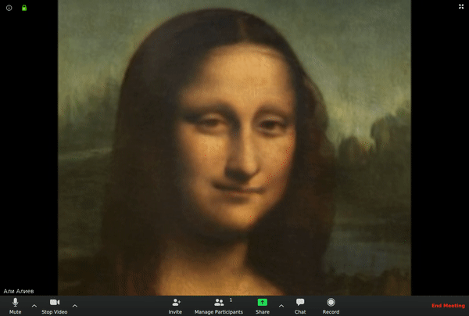
Avatarify – server for streaming video faceswap
https://github.com/alievk/avatarify-python

Slide 9
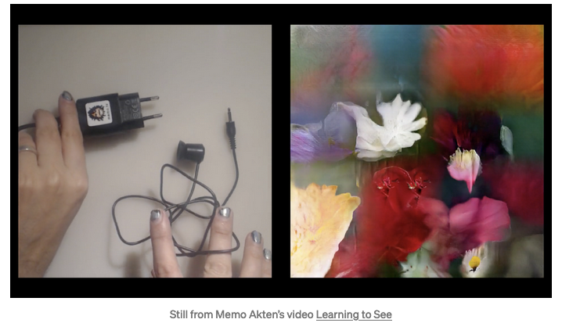
Learning to see, gloomy Sunday morning
https://www.memo.tv/works/learning-to-see/

Slide 10

https://youtu.be/UroVey4fJ_g

Slide 11
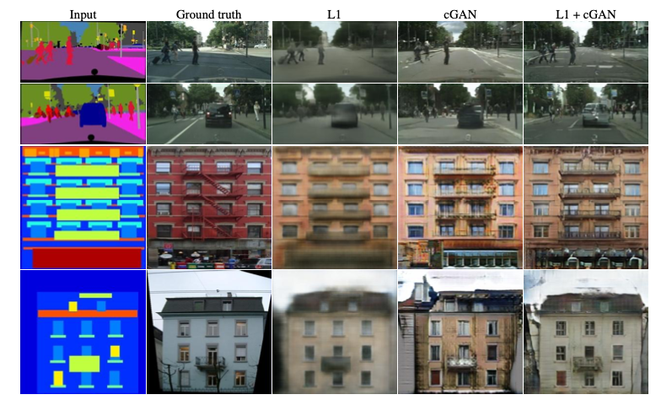
pix2pix -- CNNs trained on image pairs

Slide 12
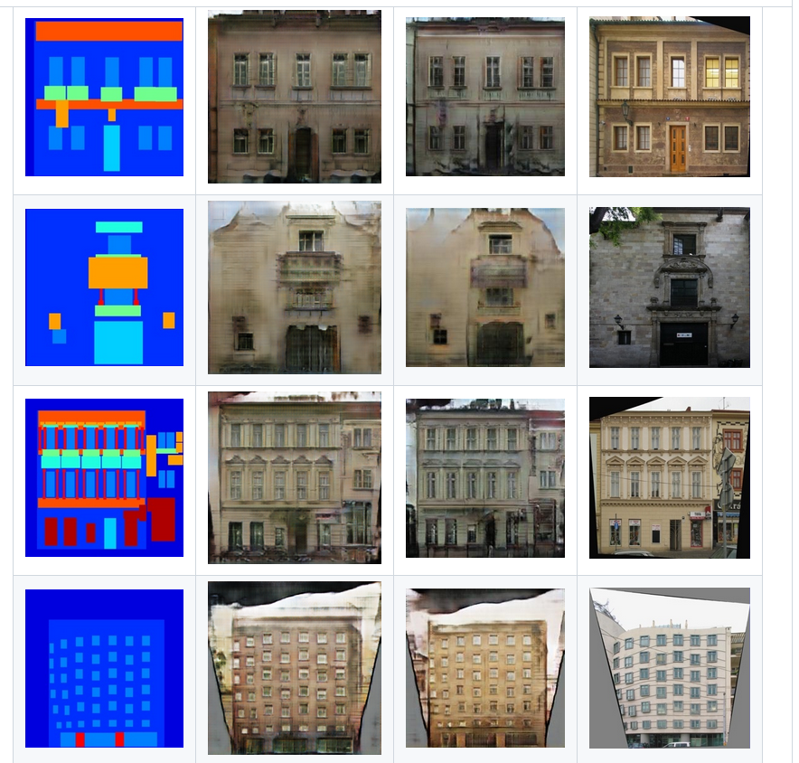
pix2pix -- CNNs trained on image pairs

Slide 13
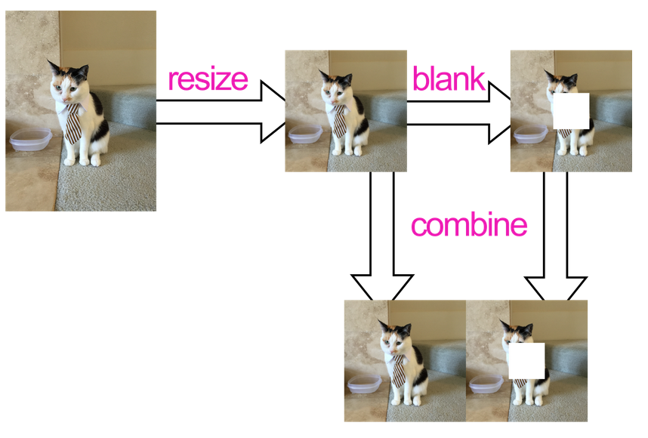
https://github.com/affinelayer/pix2pix-tensorflow

Slide 14
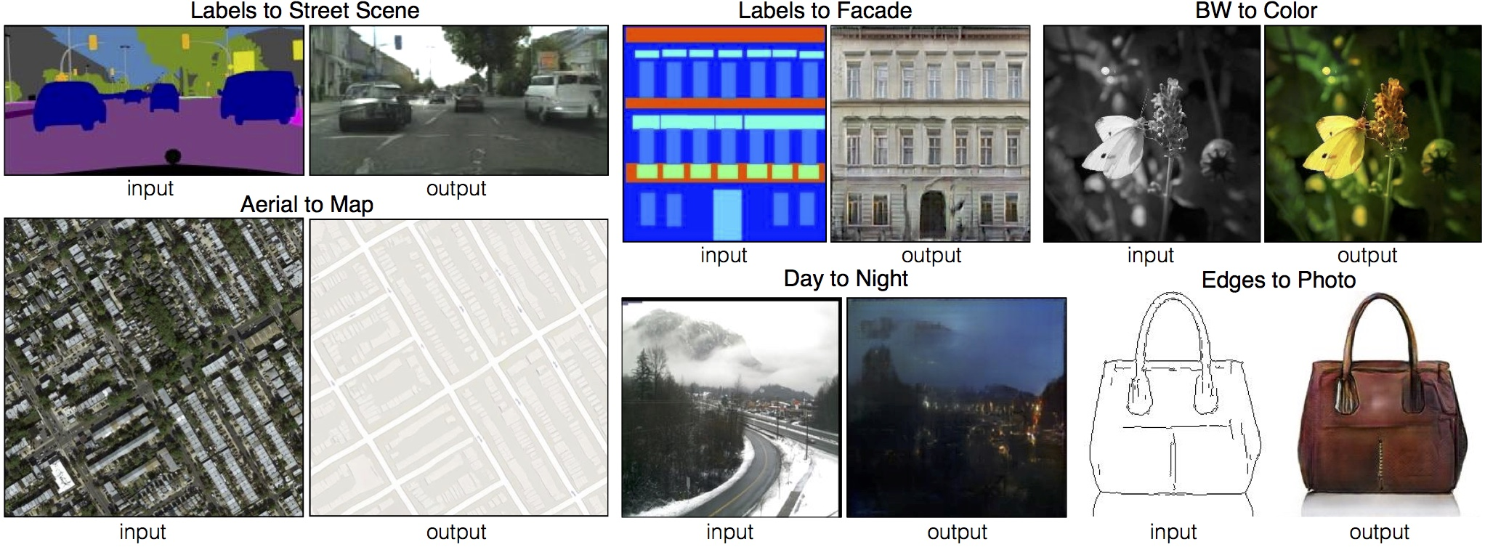
pix2pix -- CNNs trained on image pairs
https://github.com/affinelayer/pix2pix-tensorflow

Slide 15
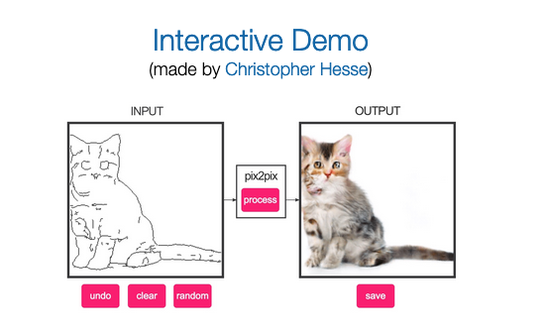
Edges2cats
https://phillipi.github.io/pix2pix/
https://affinelayer.com/pixsrv/

Slide 16
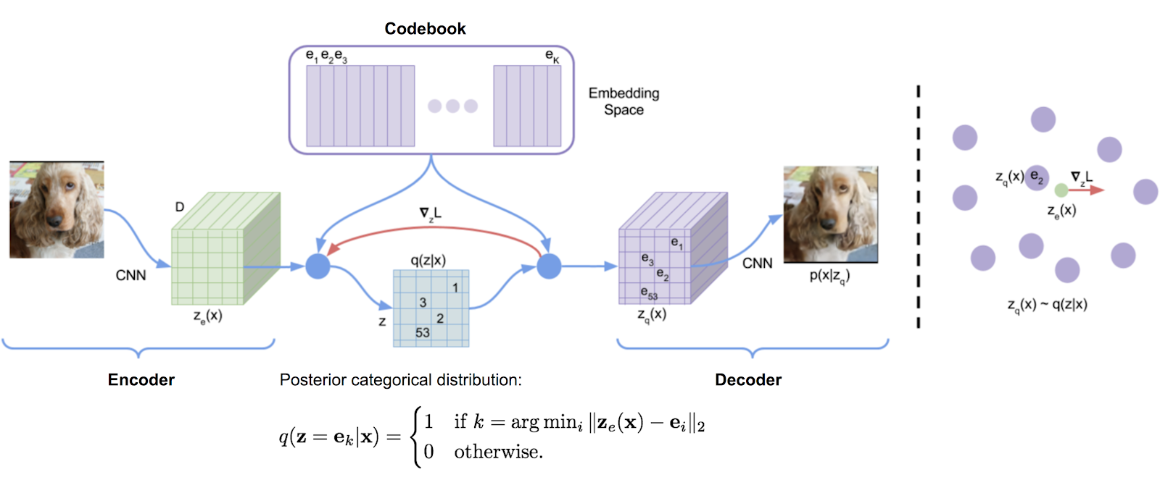
OpenAI: DALL-E: trained to generate images from text

Slide 17
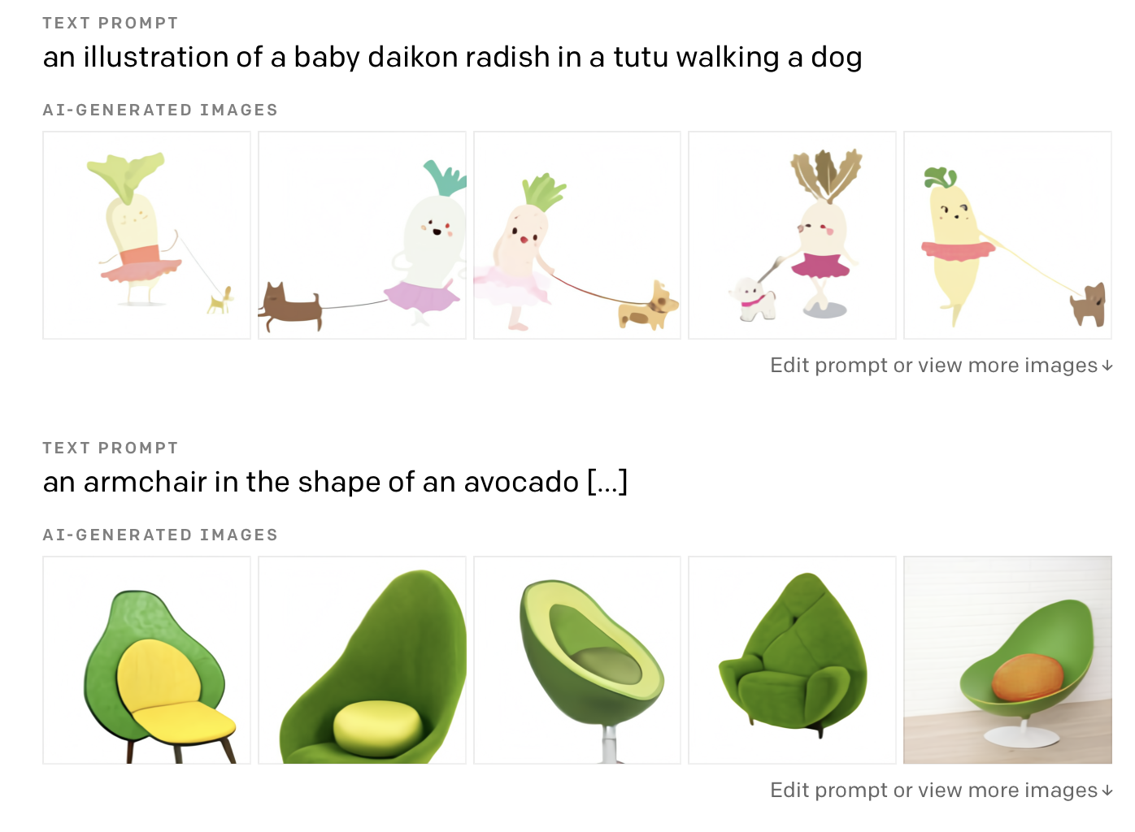

Slide 18
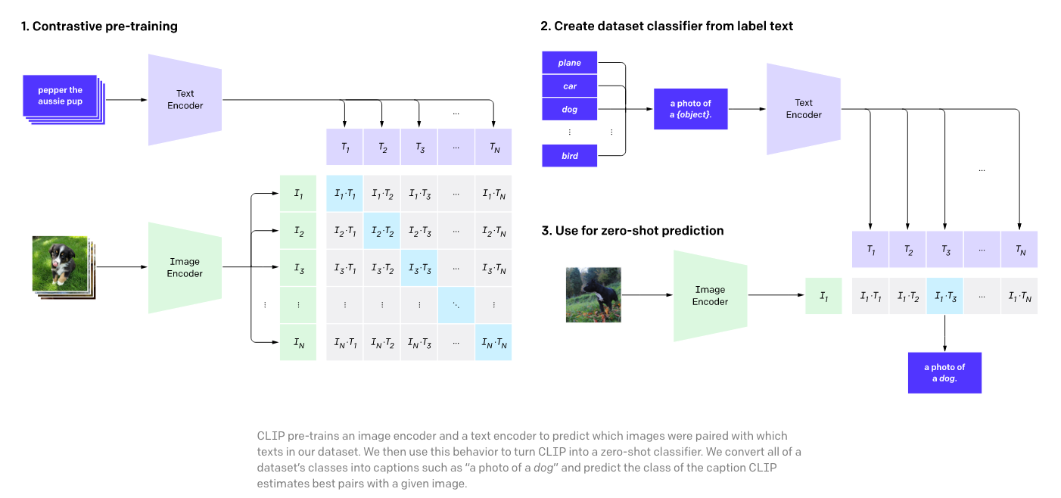
CLIP: another text-to-image framework
openAI CLIP (Jan 2021) : https://openai.com/blog/clip/

Slide 19
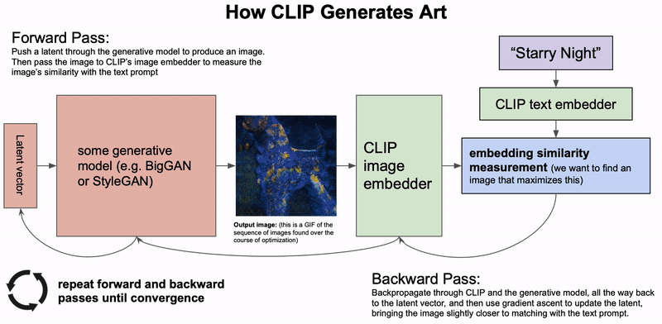
ART MACHINE: Put in text, get AI art.
https://is.gd/artmachine -> https://colab.research.google.com/drive/1n_xrgKDlGQcCF6O-eL3NOd_x4NSqAUjK

Slide 20
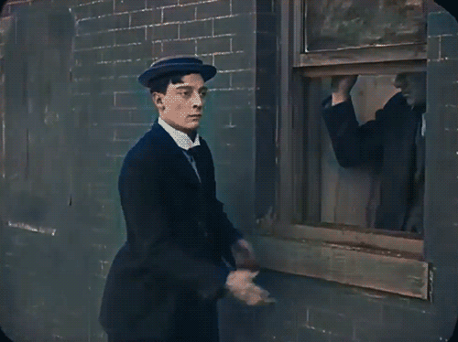
Applications abound
Colorization
Image upscaling

Slide 21
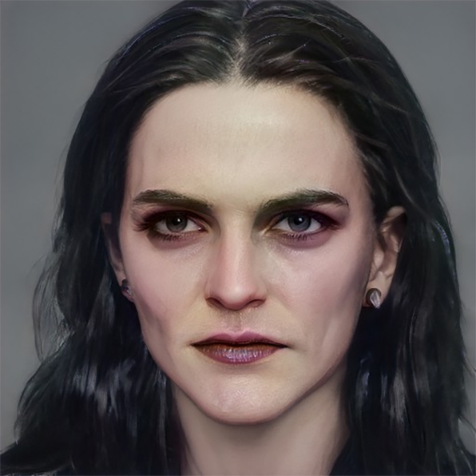
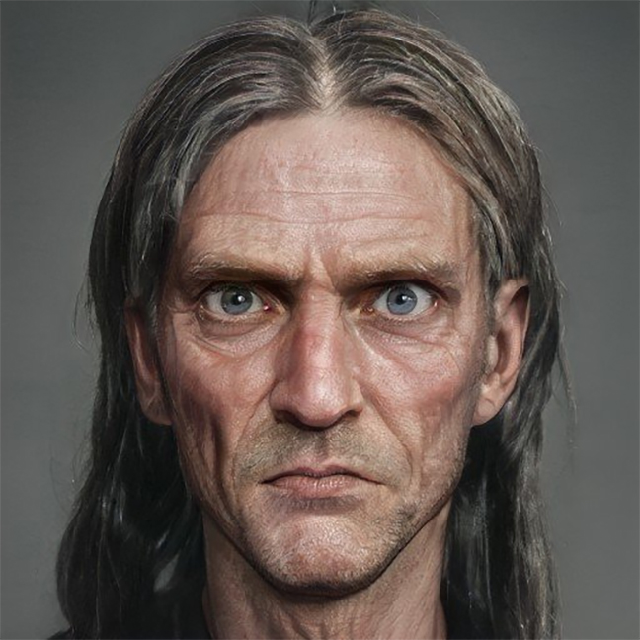
Bellatrix: (mid 40s) long shiny thick black hair, strong jaw, dark hooded eyes, thin lips, gaunt from long term imprisonment, still has vestiges of old beauty
Argus Filch: (?age?) bulging eyes, pale eyes, sunken cheeks, pasty-faced, (missing bald patch)
https://imgur.com/gallery/bwsDnLm

Slide 22
Why is this happening?
The math is decades old, but the cool applications are in the past 10 years.
The math will endure, matplotlib, ggplot, torch, tensorflow may fall out of style
Cheaper compute, cheaper storage, cheaper network, more data
Lower barrier to entry (notebooks, collab) means many more people working with ML/AI tools
Look at the amount of art! AI isn’t just for giant corporate conglomorates anymore.

Slide 23
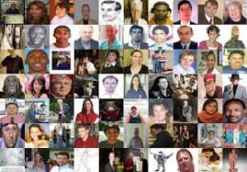
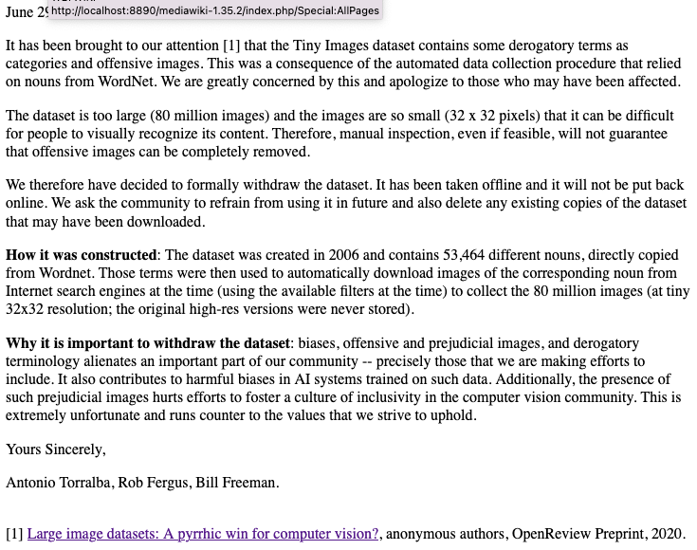
With great power comes great responsibility
https://groups.csail.mit.edu/vision/TinyImages/

Slide 24
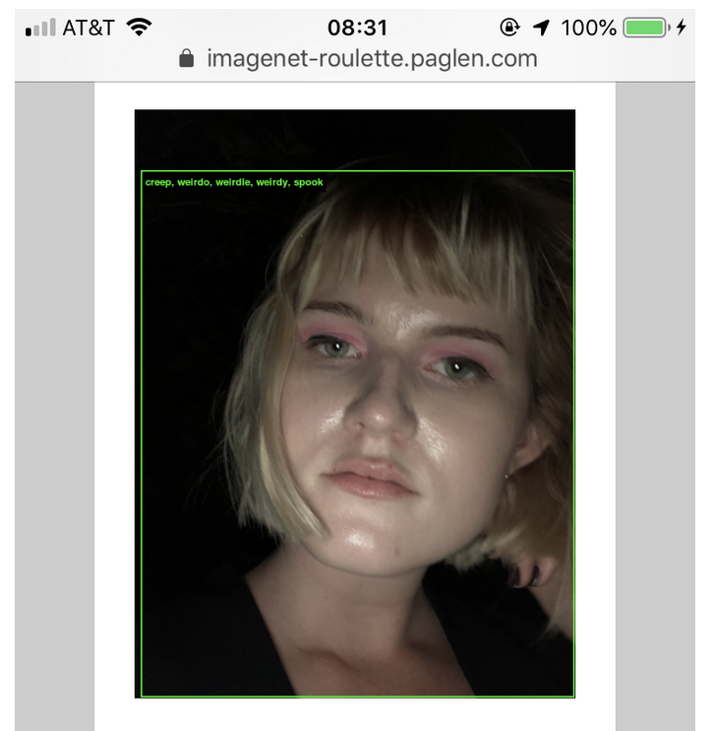
Imagenet roulette (art project)
https://excavating.ai/
ImageNet contains 2,833 subcategories under the top-level category “Person.”
As we go further into the depths of ImageNet’s Person categories, the classifications of humans within it take a sharp and dark turn. There are categories for Bad Person, Call Girl, Drug Addict, Closet Queen, Convict, Crazy, Failure, Flop, Fucker, Hypocrite, Jezebel, Kleptomaniac, Loser, Melancholic, Nonperson, Pervert, Prima Donna, Schizophrenic, Second-Rater, Spinster, Streetwalker, Stud, Tosser, Unskilled Person, Wanton, Waverer, and Wimp. There are many racist slurs and misogynistic terms.
Image of journalist Izzy Stephen tagged with a subset of Imagenet’s unflattering person labels.
https://medium.com/@isobel.stephen/what-can-we-learn-from-ai-art-4b0a52476dd9

Slide 25
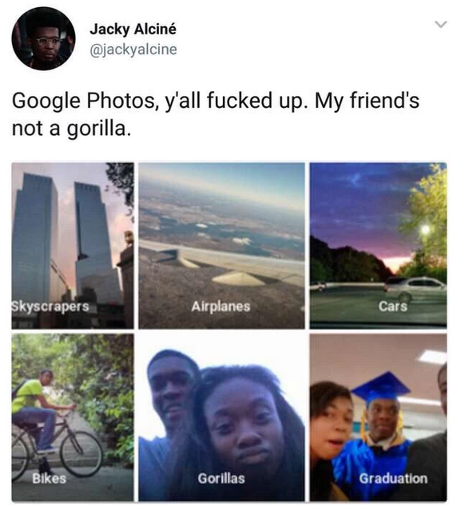

Slide 26
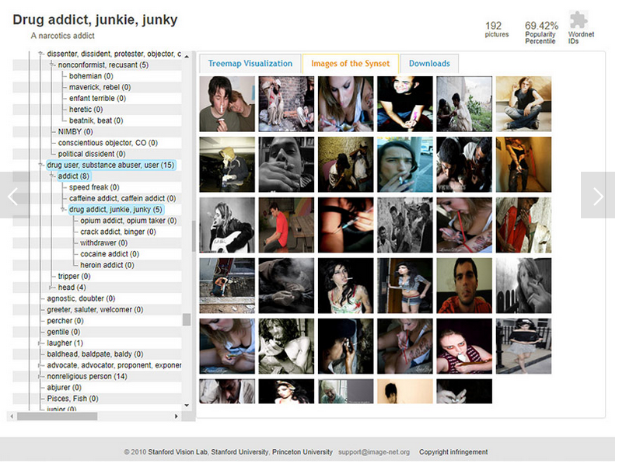
Image databases need careful review..
http://www.wired.com/story/viral-app-labels-you-isnt-what-you-think

Slide 27
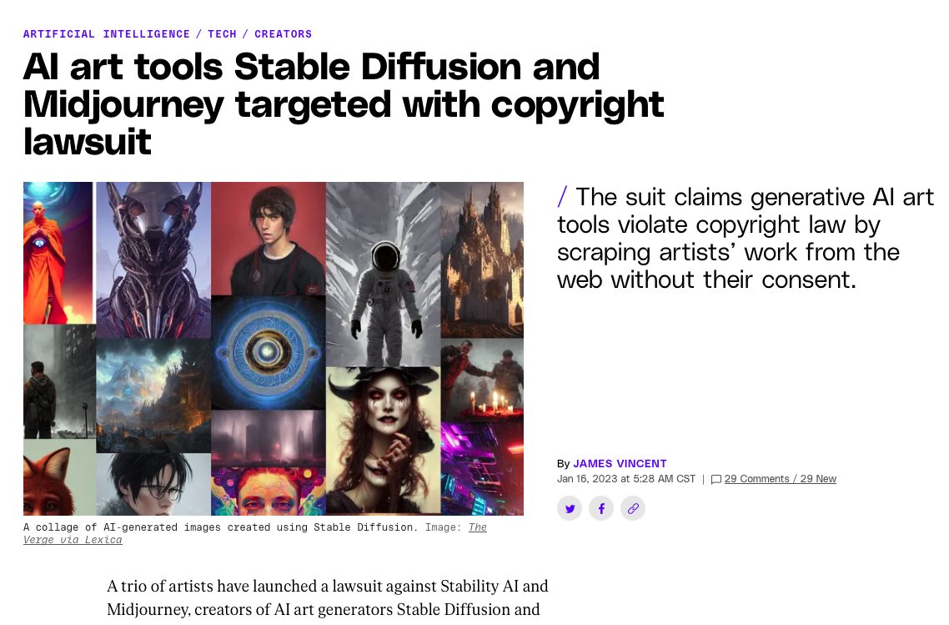

Slide 28
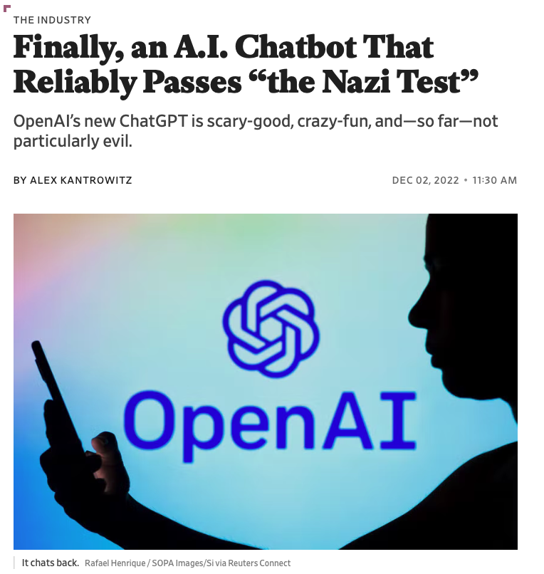

Slide 29
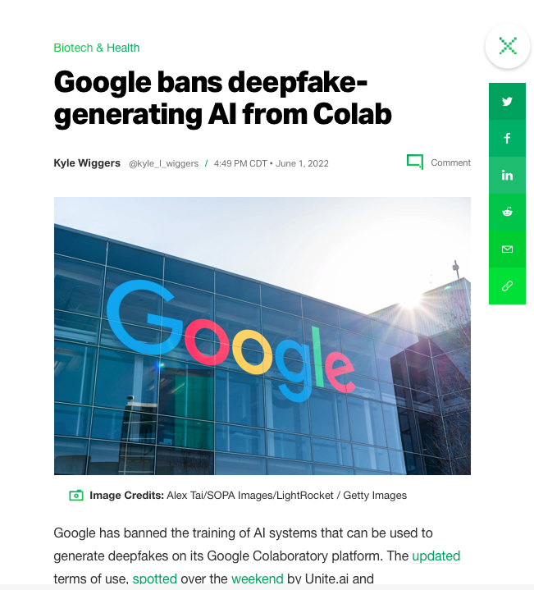
https://www.bleepingcomputer.com/news/google/google-quietly-bans-deepfake-training-projects-on-colab/
The complete list of disallowed projects are listed below:
file hosting, media serving, or other web service offerings not related to interactive computing with Colab
downloading torrents or engaging in peer-to-peer file-sharing
using a remote desktop or SSH
connecting to remote proxies
mining cryptocurrency
running denial-of-service attacks
password cracking
using multiple accounts to work around access or resource usage restrictions
creating deepfakes

Slide 30
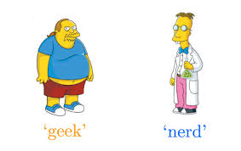
How much is technical?
What is the difference between a geek and a dork?
Programmers in corporate environments don’t struggle with syntax, documentation, troubleshooting. They struggle with managing relationships.
When do you ask for help? Who do you ask? (Type I errors and Type II errors both cut into productivity)
In academic environments, specialization of knowledge (stovepiping) means elite researchers just collaborate to get the expertise they need.

Slide 31
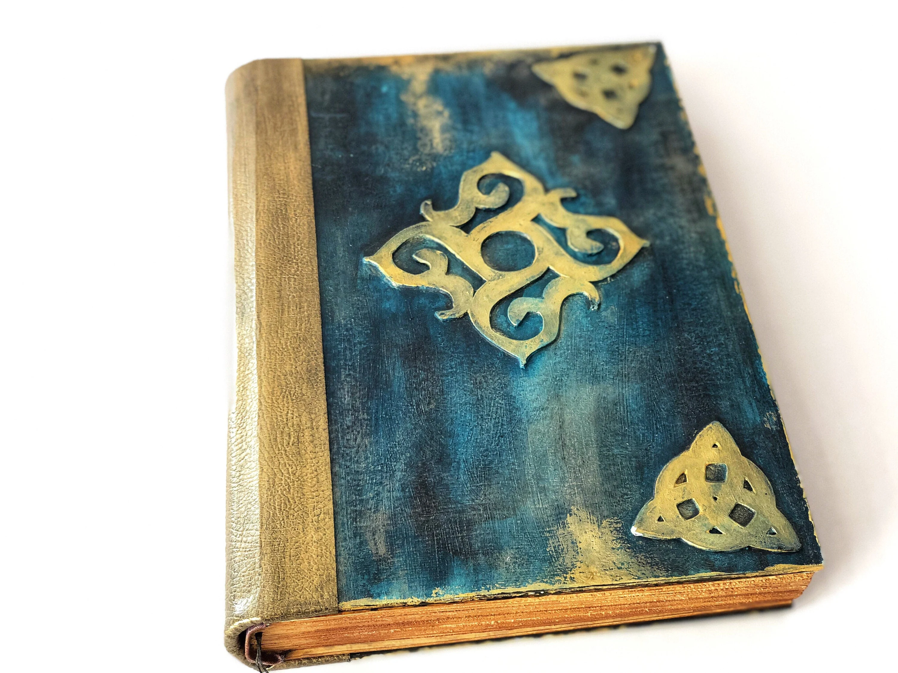
Try to use the spells in the spellbook for good?

Slide 32
Improvements for DATA221 in the spring?
Missing: rigorous theoretical background (sklearn can hide important details) (x2)
DATA213 – (math methods was not coding-heavy) (This class had a lot of debugging)
120 & 136 only offered in the spring
Needs to include more background on linear algebra. (SVD + ANN)
More background on computation ( CS has a math / computing split for ML)
Algorithms might be helpful. (Data engineering?) Gradient descent + backpropagation + convolution MORE hallucinations math
Domino effect in homework .. compare to previous homework’s output …
DATA119 : Very explicit examples ... transition to production-worthy code … HARD
(Where do you want to end up?) (+portfolio development)
Would have liked to see applications beyond image-processing (economics, medicine)
Ethics class: weekly readings..
Creating synthetic data (problem set)

